Slide 1

Visualization and Analysis Tutorial Presentation for Feedback
Group Id: A196 Name of Student Presenting: Aayushi Vijaybhai Kosambia
Date: 17-11-2024

Slide 2
VISUALIZATION
Part 1:

Slide 3
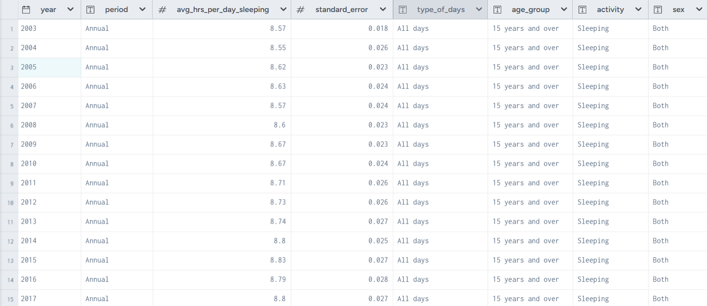
We are using the dataset DS240, Time Americans Spend Sleeping .xlsx to answer our Research Question “Is there a difference in the average hours spent sleeping per day between males and females over the years?”
The dataset has 945 rows
The dependent variable is Average hours spent sleeping per day
The independent variable⁴ is Sex (Male or Female) and Year

Slide 4
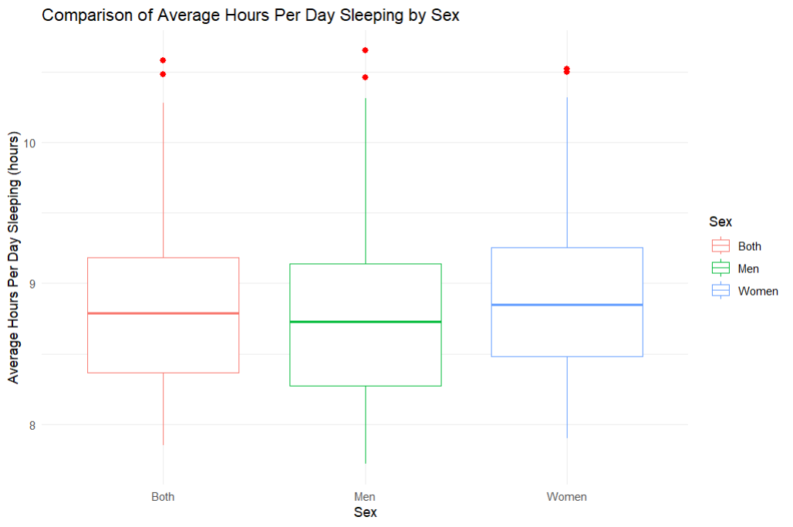
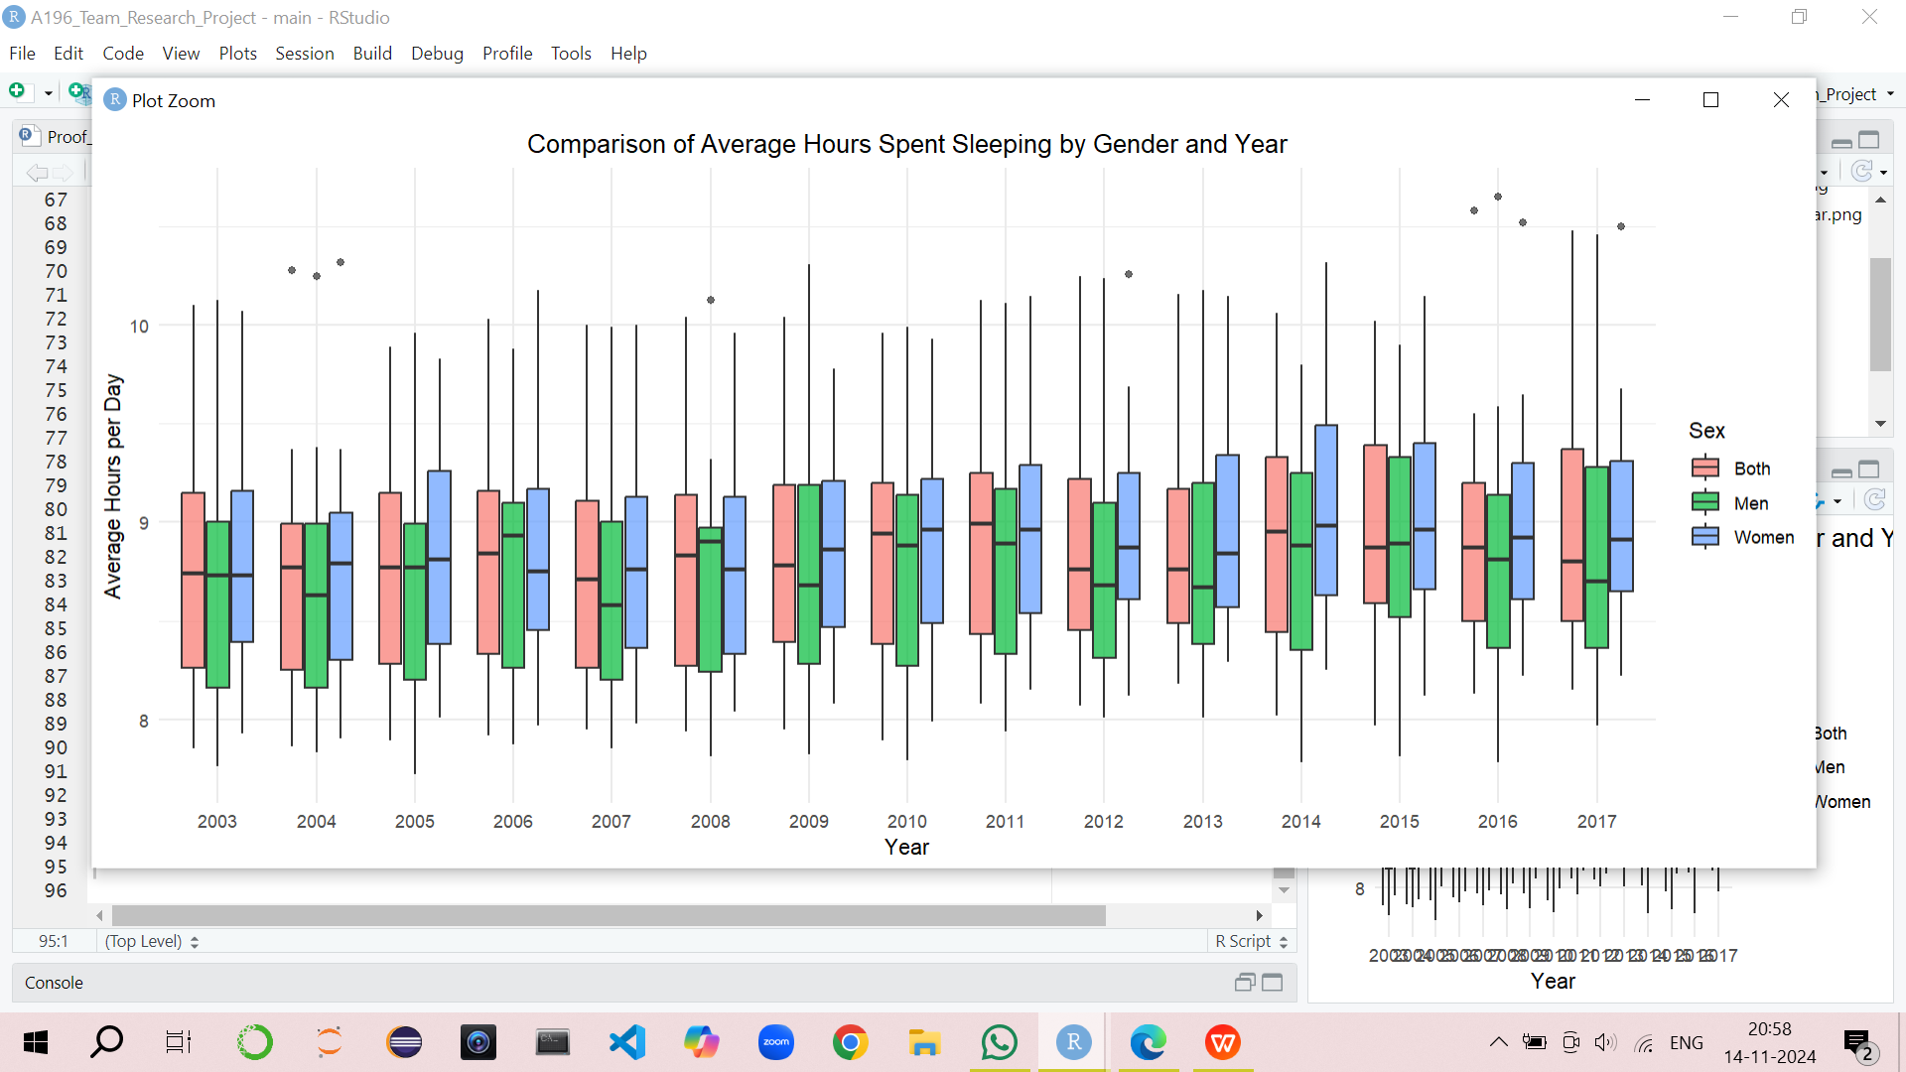
1. Boxplots
Where your research question asks about
Comparison of means/medians: Include two plots

Slide 5
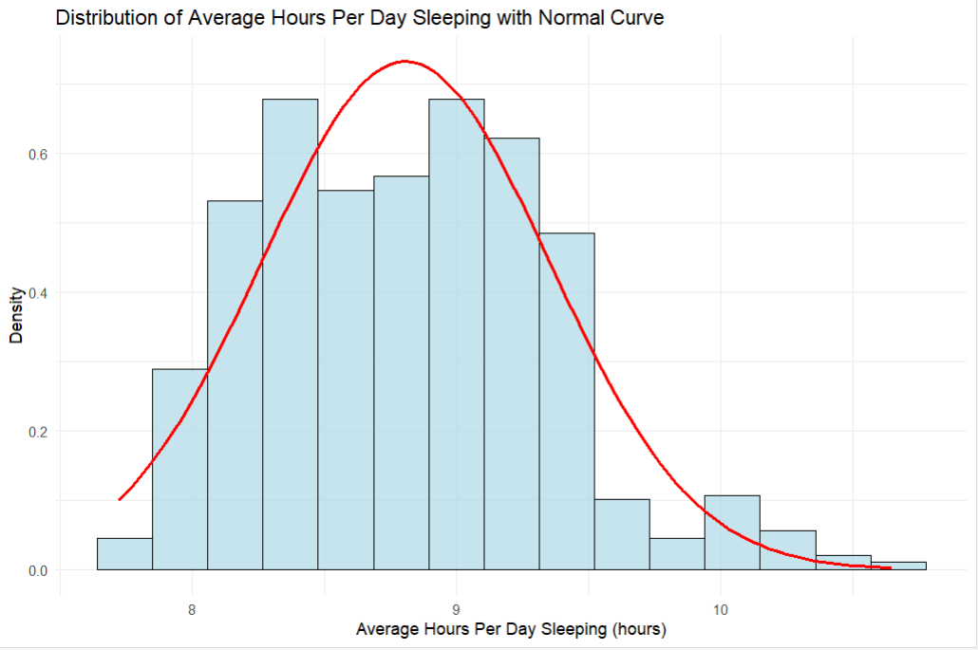
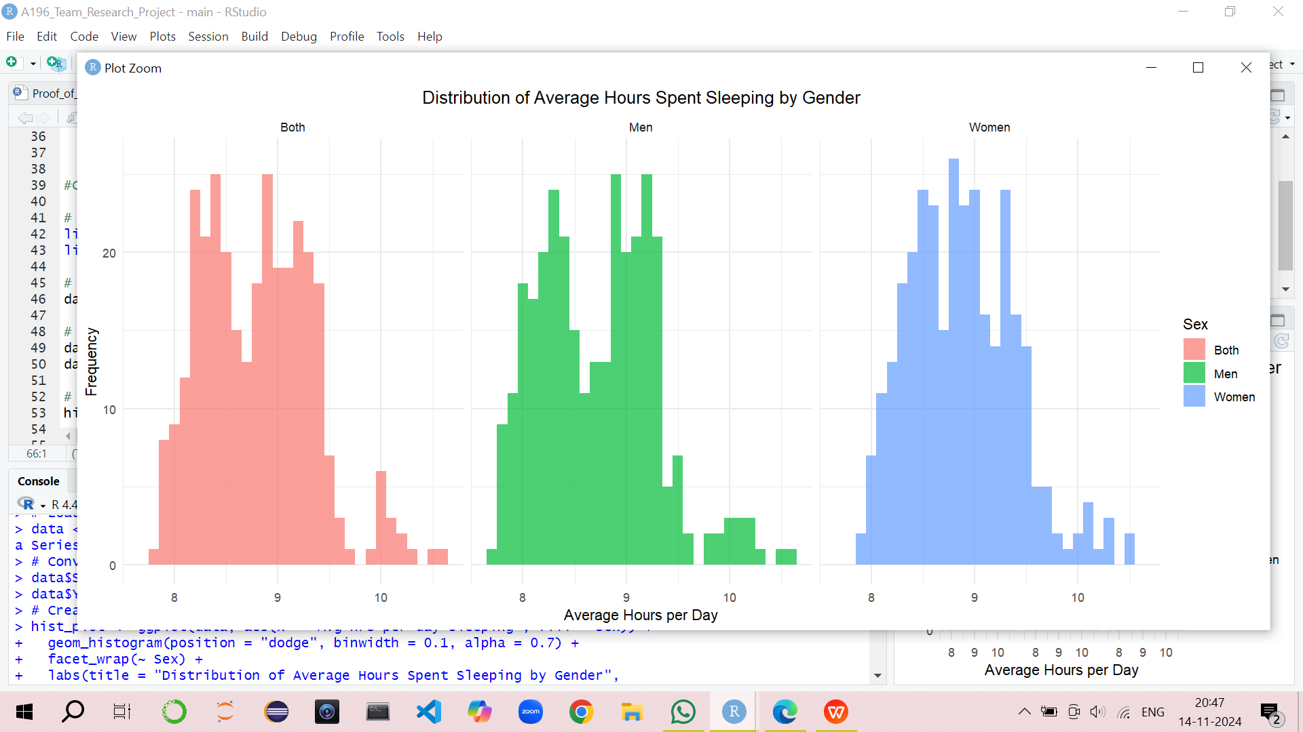
B2. A histogram to include the normal curve overlay

Slide 6
Analysis
Part 2:

Slide 7
Here is a Histogram showing the frequencies of our dependent variable to include the normal curve overlay.
Our RQ asks about Correlation
The normal curve overlay does not follow the shape of the underlying data, so for our analysis we use the non-parametric test for correlation that does not assume normality: Kendal’s Tau
7
Notes:
7

Slide 8
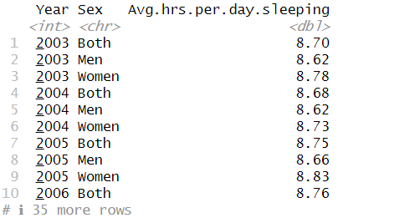
Here is a table (matrix/cross tabulation) showing our dependent variable as rows, and our independent variable as columns. We have at least two values for both variables that are independent of each other (no overlap).
Our RQ is about Differences in proportions
8
Notes:
8

Slide 9
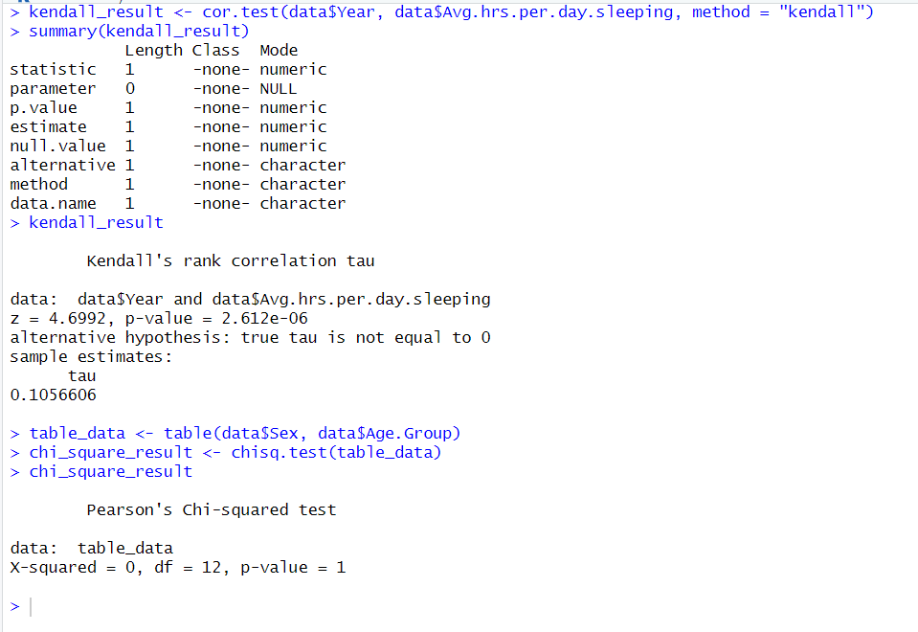
R Script and Results
PRE 7COM1079-2022 Student Group No: ?????
9
Test statistic (z): 4.6992
Estimated tau: 0.1056606
P-value: 2.612e-06
The p-value is much smaller than 0.05.
since the p-value (2.612e-06) is less than 0.05, the result is statistically significant.
Since the result is not significant, we can conclude that there is no significant association between Sex and Age.Group.
Notes:
9

